Slide 1



BIT-PASS MANAGER™
By- Bhartesh, Shivaan & Ishaan
B

Slide 2

Theme:
Enhancing Local Governance through Technology:

Slide 3
The Problem:
C

Slide 4

What is the problem?
The increasing use of the internet in our daily lives exposes us to critical challenges. Cyber attacks, compromised cyber security for Indian citizens, ransomware incidents, massive data breaches, Bitcoin scams, and the rise of doxing activities pose severe threats. These threats certainly result in substantial financial losses each month, endangering individuals and organizations.
C

Slide 5
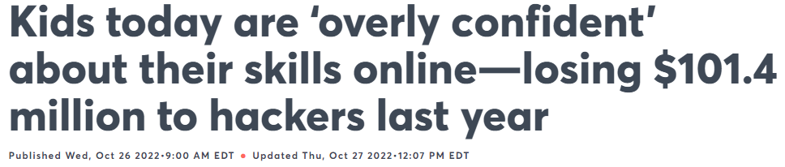
B

Slide 6
The Solution:
C

Slide 7
Solution
Our upcoming digital security solution, is designed to prioritize Indian Citizen’s online safety. With its advanced features, it will keep the data always backed up and monitor activities to ensure security. Users will be able to securely save any kind of data, including cryptocurrencies, passwords, APIs, and more, in our 5-layered AI-protected vault. Saving your most confidential data will take just a few minutes.
C

Slide 8
Our Product
Introducing BIT-PASS MANAGER™: Our upcoming digital security solution, A powerful mobile, desktop, and website application designed to prioritize your digital security. With its state-of-the-art 5-layer protected digital vault which uses advanced advanced artificial intelligence (AI), BIT-PASS MANAGER™ provides an unparalleled defense against data breaches and ransomware attacks. Our innovative solution ensures your sensitive information remains secure, empowering you to navigate the digital landscape with confidence. Say goodbye to vulnerabilities and embrace peace of mind as BIT-PASS MANAGER™ safeguards your digital presence like never before.
B

Slide 9
How Will It Improve Local Governance:
By using our encryption technology, local government agencies can secure sensitive information, ensuring that citizen data, financial records, and confidential communications are protected from unauthorized access. Improved data security builds trust among citizens and stakeholders, fostering a positive perception of the government's commitment to safeguarding their information.
Implementing Our password manager can simplify and secure citizen access to e-government services. This streamlined access enhances user experience, encourages greater citizen engagement, and promotes a transparent and efficient service delivery process.
Secure communication platforms powered by our encrypter enable local officials to share information, collaborate, and make decisions in a confidential and tamper-proof environment.
Our password manager can help local government employees securely manage their access to various internal systems and databases. This reduces the risk of data breaches caused by weak passwords and unauthorized access.
If your password manager is used for secure digital identity and authentication, it can contribute to secure online voting systems. This enhances election integrity, minimizes the risk of voter fraud, and ensures accurate representation in local governance.

Slide 10
Scientific Principle Involved:
BIT-PASS MANAGER™ incorporates the basic and major principle of encryption, which is a fundamental concept in information security.
Encryption involves encoding data in a manner that renders it unreadable to unauthorized individuals.
BIT-PASS MANAGER™ utilizes mathematical algorithms to transform original data into a scrambled format.
The encrypted data can only be decrypted and accessed using the appropriate encryption key.
Encryption is employed within BIT-PASS MANAGER™'s 5-layer protected digital vault, ensuring the security and inaccessibility of sensitive information.
By utilizing encryption, BIT-PASS MANAGER™ ensures that potential attackers are unable to gain unauthorized access to stored data.
C

Slide 11
The Working:

Slide 12
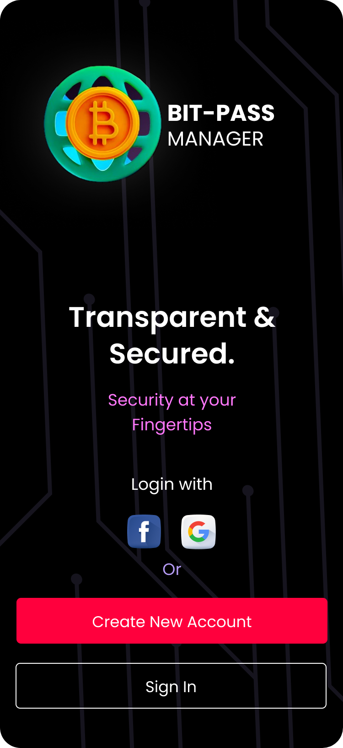
Welcome Screen UI
API Login
Our Tagline
Login With Google or Facebook In Seconds
Security at Your Fingertips
New Account
Sign In
Create a new Account in just few steps
Sign In Manually

Slide 13
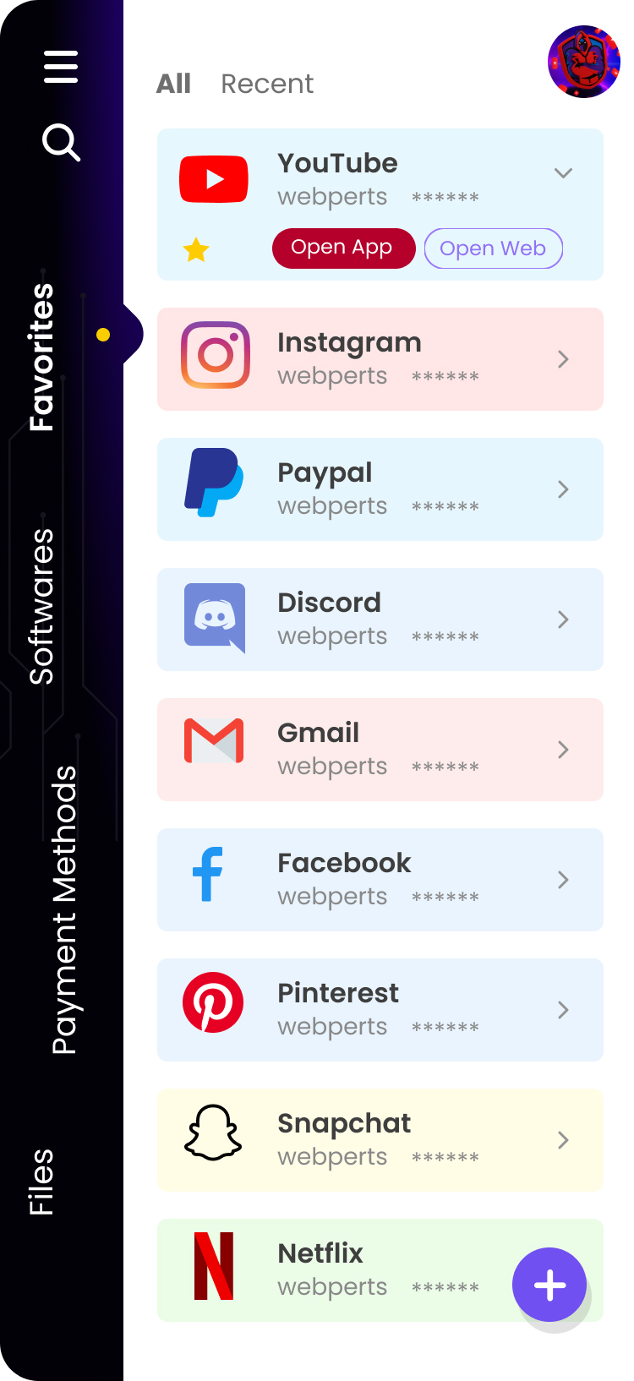
Home Screen UI
Account
Database Type
Click on your Profile to View your account status.
Select The database Type You Want to View
Access Data
Access Your data after Passing Security Check
New Data
Click the + icon to store new databases.

Slide 14
The Business plan:

Slide 15

The Single point of Failure of Many existing managers:
The biggest disadvantage of a password & a file manager is that because access to all of your passwords is protected by a single strong password, there is a potential risk that an attacker could gain access to all of your passwords with one hack of your password manager.

Slide 16
Target Audience:
Gender:
Age:
50%
-20
73%
50%
+30
27%

Slide 17
Our Plans:
₹0
ALL BASIC FEATURES
10 Vaults 5 Layered Protection
Basic
₹99
Premium AI Features
Unlimited Vaults Ad Free Experience
Premium

Slide 18
3 Year Estimate Investment:
1,00,000 US Dollars
82,58,230 Indian Rupees

Slide 19


But due to our 2 pre-existing successful companies we Will be able to run our product AT ₹0 COST, just because most of our resources in need would be provided by our pre existing companies free of cost.
HOSTING COMPANY
SOFTWARE DEVELOPMENT COMPANY

Slide 20
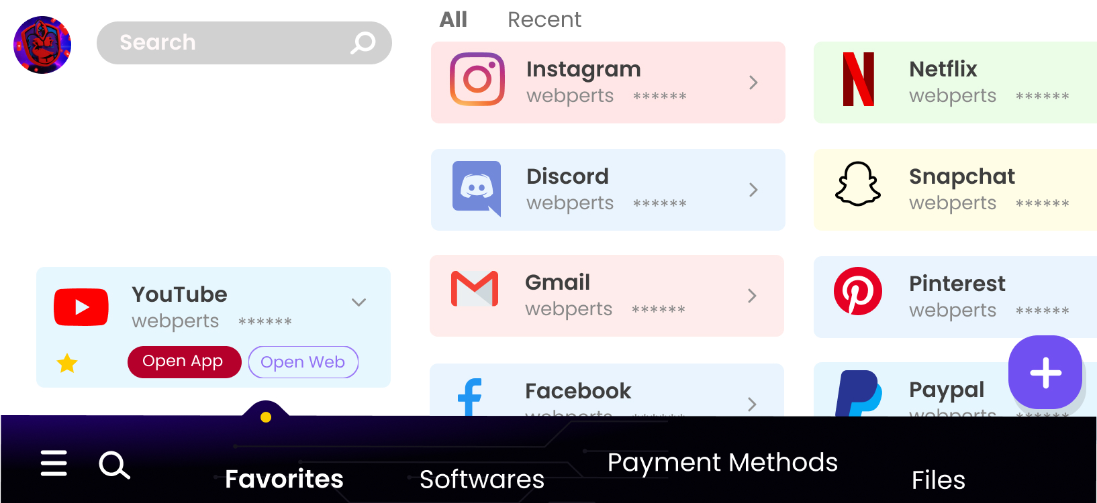
Product demo

Slide 21


VIDEO-:

Slide 22
Thank You
An Upcoming Start-up:
By- Bhartesh, Shivaan & Ishaan

